Slide 1
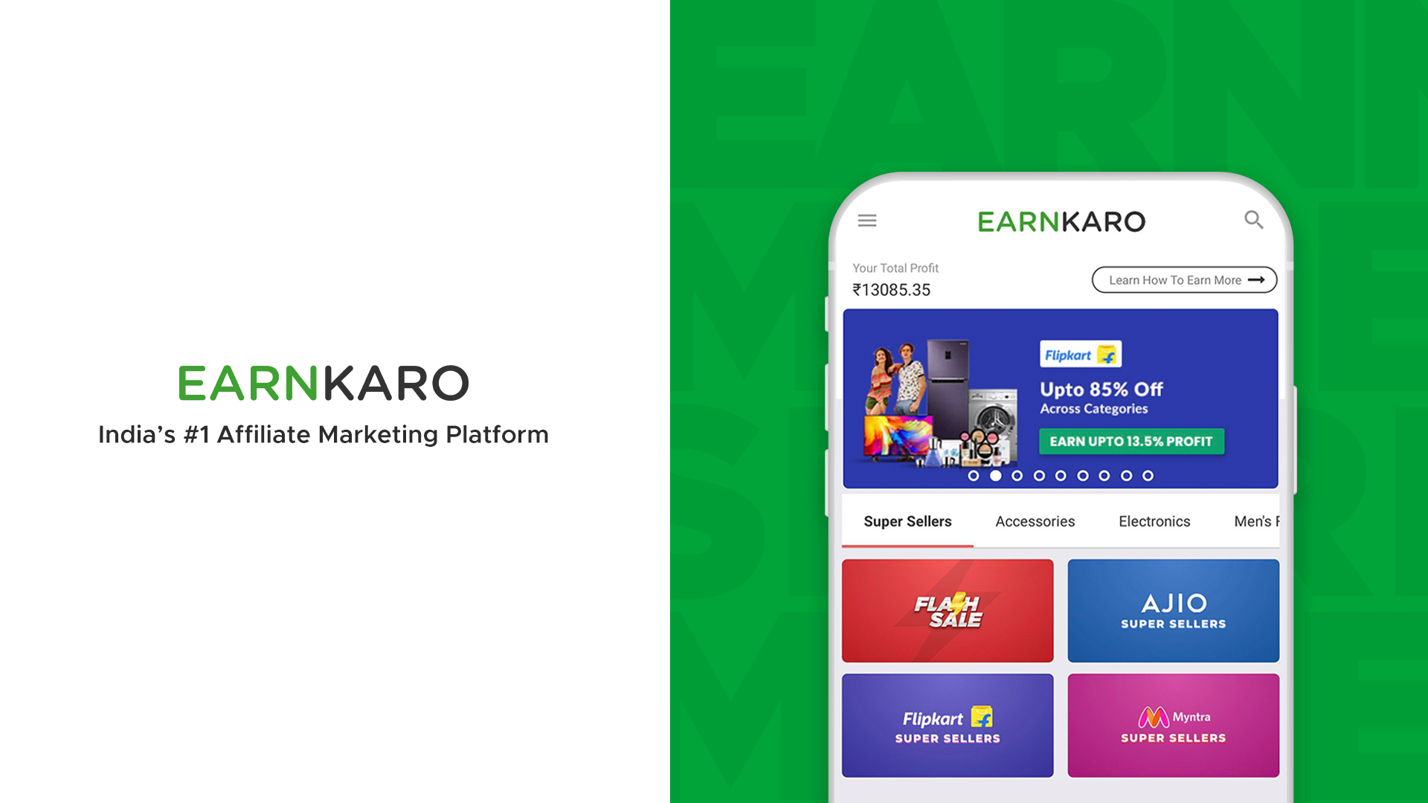

Slide 2

EK Affiliaters
The most efficient tool for creating and managing EarnKaro ‘Profit Links’
What is EK Affiliaters?
A tool designed to help users create EarnKaro profit links on a large scale
Simplifies converting links into profit links, creating automatic posts, and replacing text within your posts
Why use EK Affiliaters?
Eliminates manual, time-consuming steps in creating profit links and posts
Create thousands of links quickly during sales events
Automates the conversion of regular posts into profit posts

Slide 3
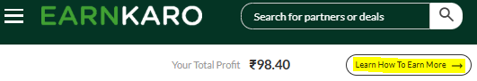
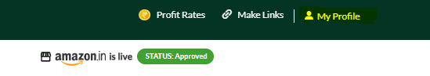
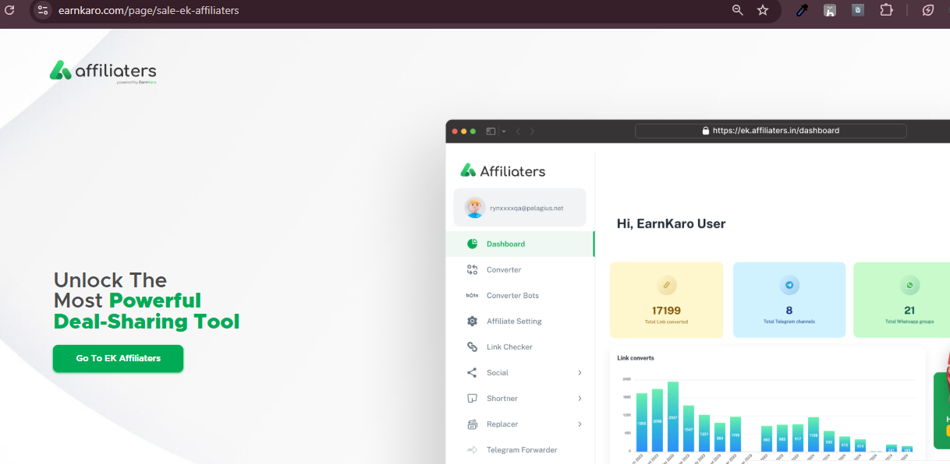
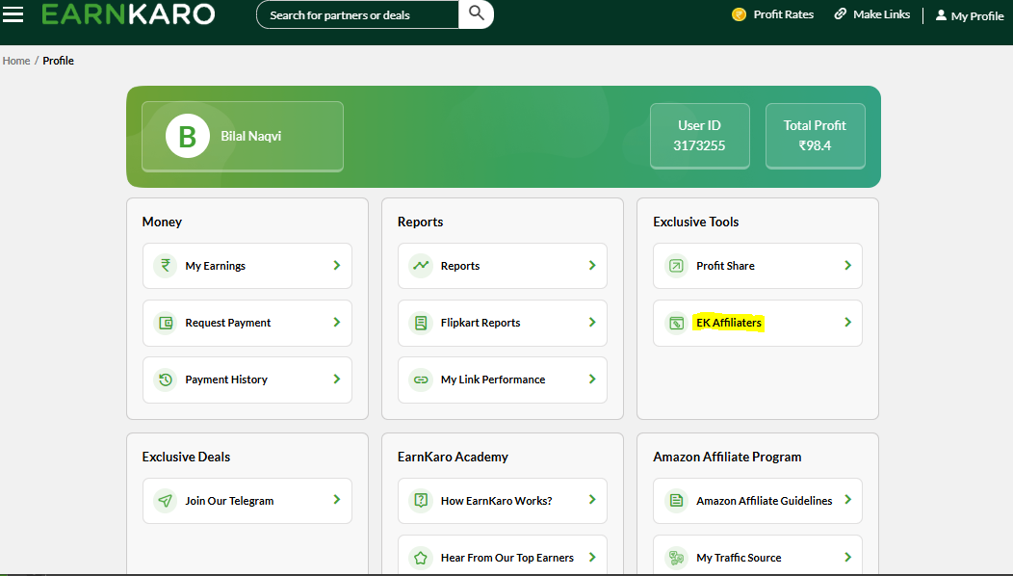
How to access Affiliaters?
1. Visit the App/M-site/ Website
2. Click on the Highlighted Buttons to reach the ek.affiliaters.in

Slide 4
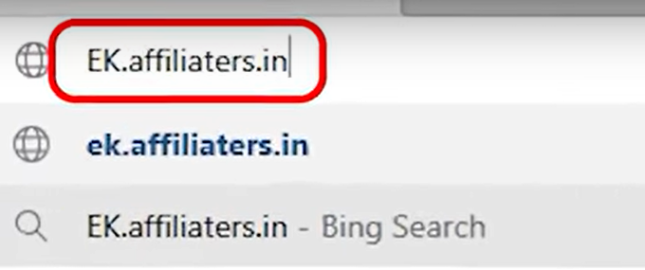

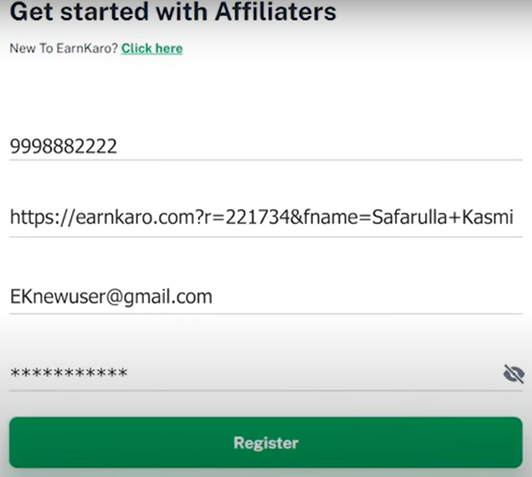
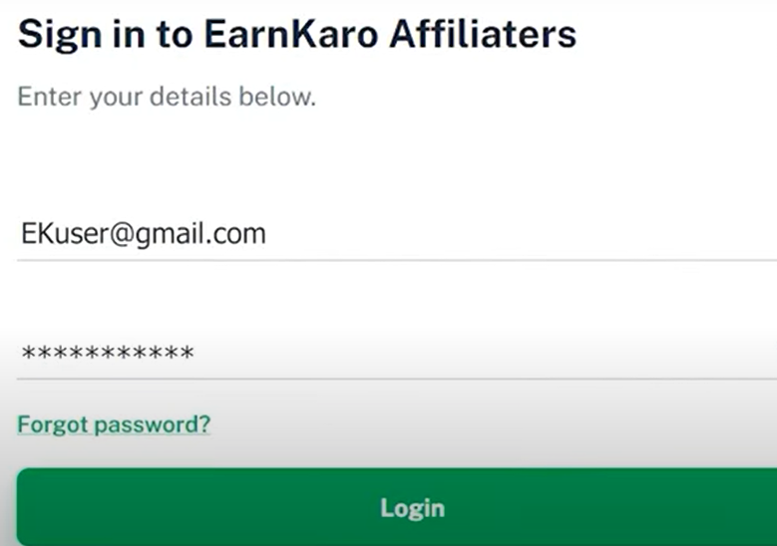
Account Creation and Login Directly visiting the affiliaters website and getting started with EK Affiliaters Program
Creating a New Account (If you don't have one)
Press “Get Started”
Begin by visiting EK.affiliaters.in
Add your mobile number, an EK referral link, and your email address, then set a password and click on Register
Log in using the email address that is linked to your EK account

Slide 5
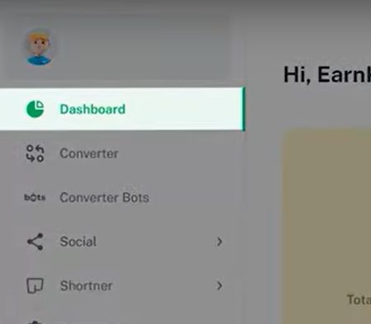
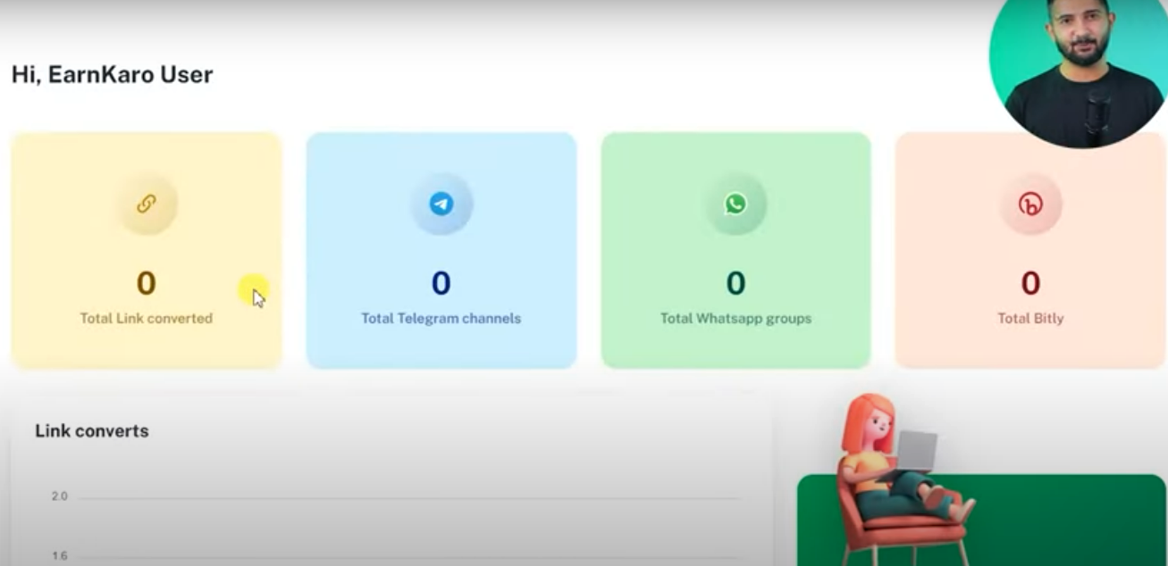
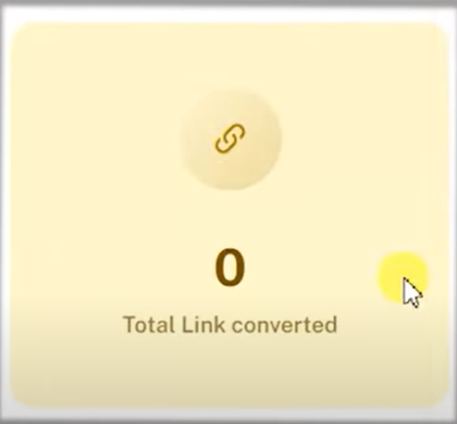
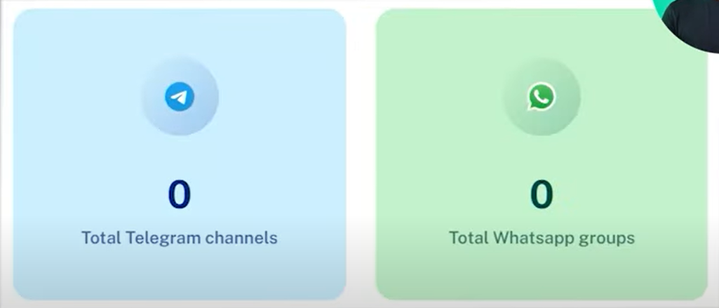
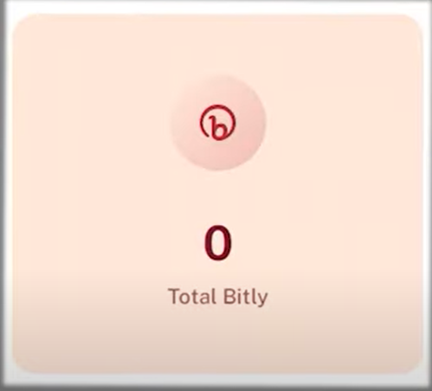
Understanding Your Dashboard The dashboard provides a summary of the links you have created using the tool
Click on “Dashboard” to access the interface
Your Dashboard appears something like this
Key Metrics Displayed
You can see how many links you have converted using the tool
You can see how many links are connected (once the data is there)
You can track the number of Bitly links you have consumed

Slide 6
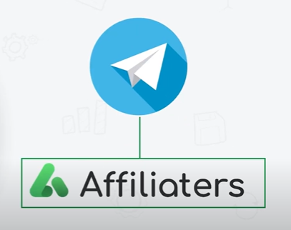
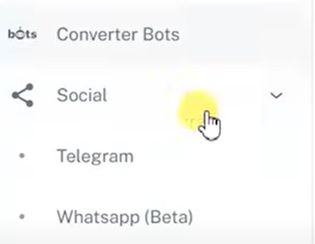
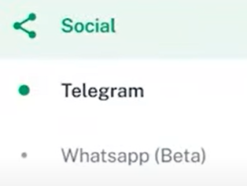
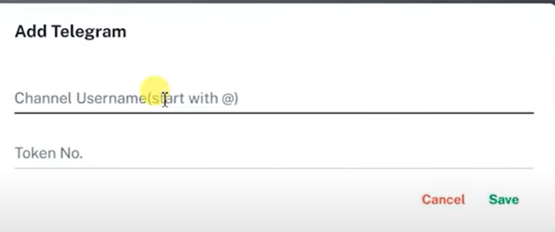

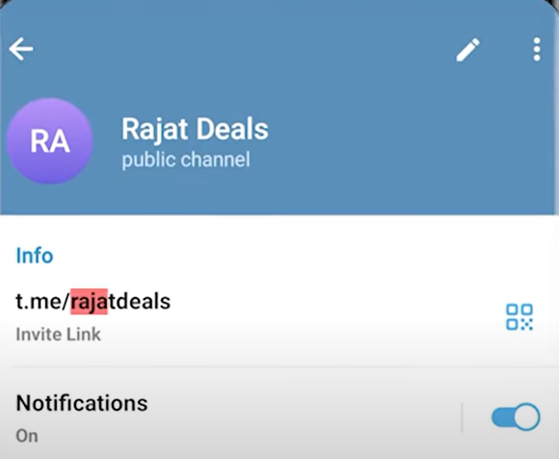
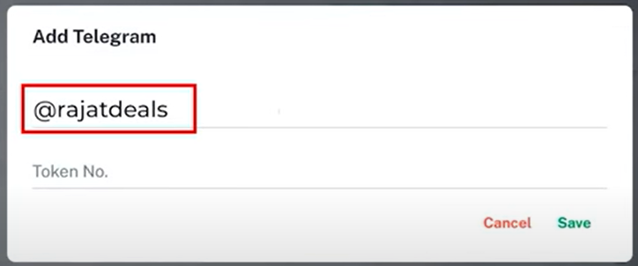
Set-Up Telegram Auto-Forwarder Bot To enable automatic forwarding of your converted links to your Telegram channel
To link your Telegram account to EK Affliaters➔
Click on Telegram
Click on Socials
Go to your TG channel to find Username
Click on Add Telegram channel Username and Token Number
Click on Add Telegram
Add your username with ‘@’ sign before

Slide 7
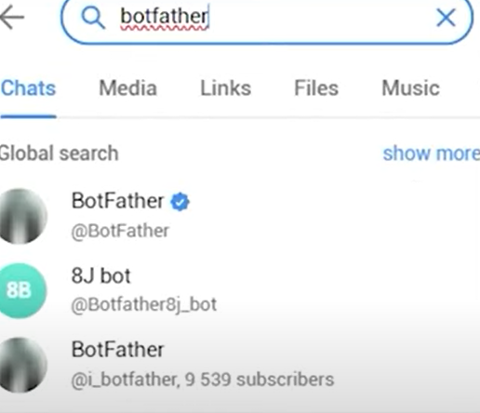
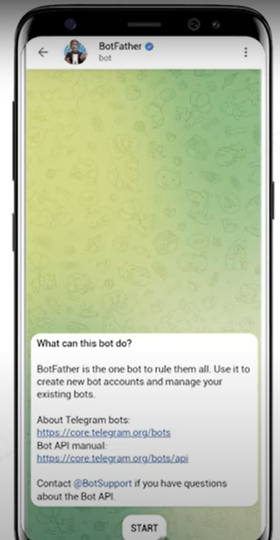
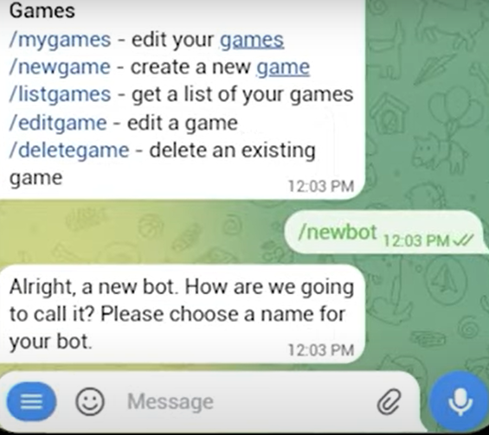
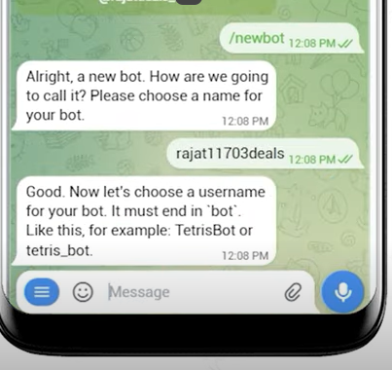
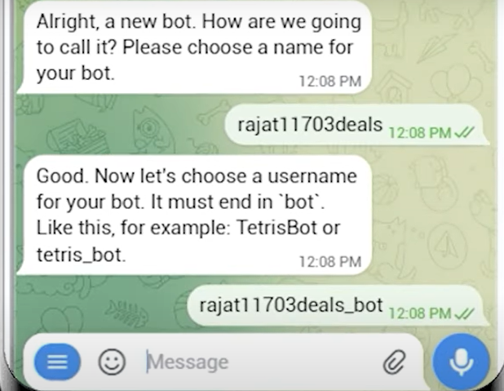
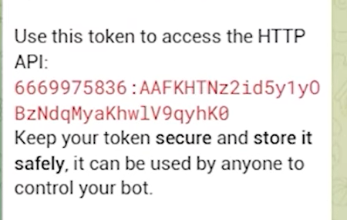
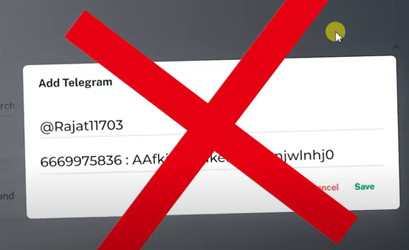
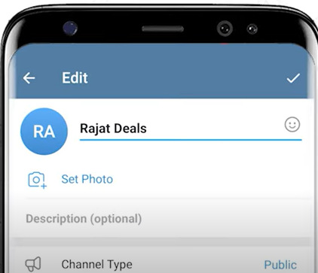
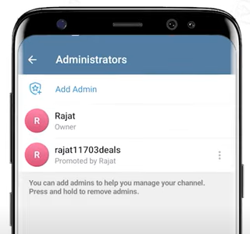
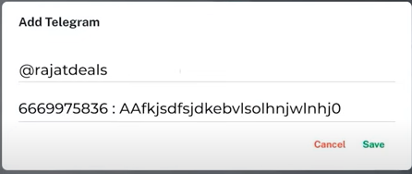
How To Find Token Number?
Search for "BotFather"
Press BotFather's "Start" button
Type the command /newbot
and press Enter
Create a name for your bot
Enter your username with “_bot”
A Token No. is generated
Do not paste it directly
Go to your TG account
Then, Add your bot as an admin in your TG account
Now, You can add your Token No. in your EK Affiiaters account

Slide 8
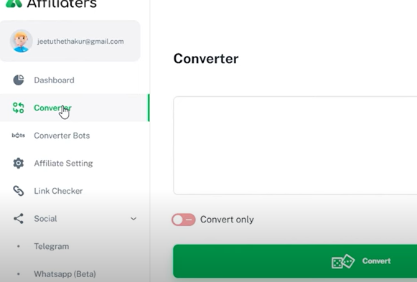
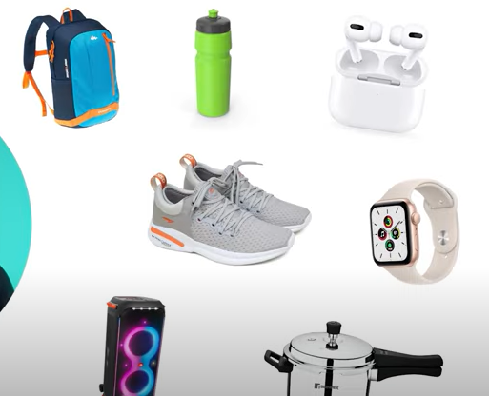
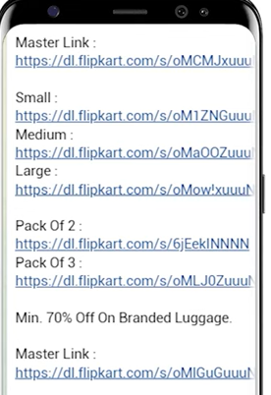
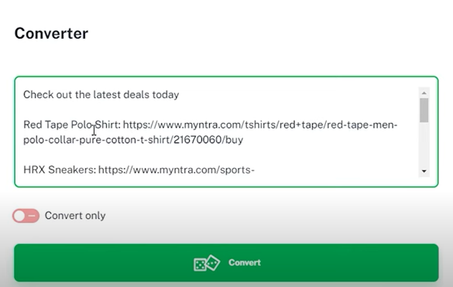
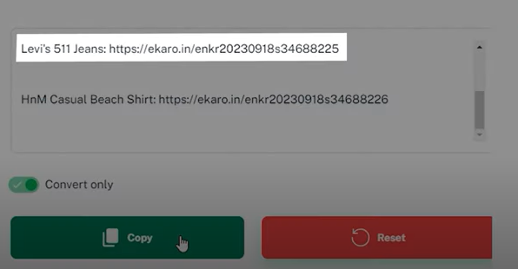
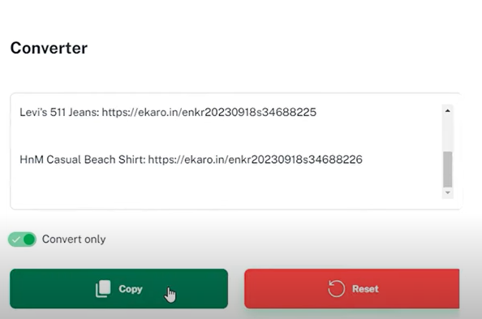
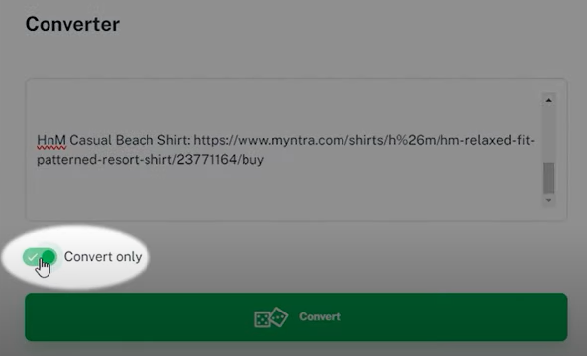
Converting Links & Auto-Posting
Powerful Link Conversion: ◦ The converter is designed to convert multiple deal links into profit links efficiently
◦ The best part is that you don't need to make any changes to your original post
Simplified Posting Process:
◦ You can simply paste your post content into EK Affiliaters
◦ Upon pressing the "Convert" button, your post is converted into an Earnkaro link and is ready to be automatically shared on your connected Telegram channel
◦ Upon clicking on "Convert Only" Toggle, your post is only converted into an Earnkaro link

Slide 9
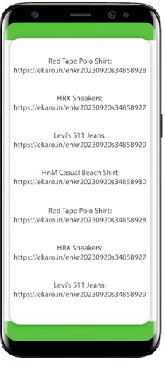
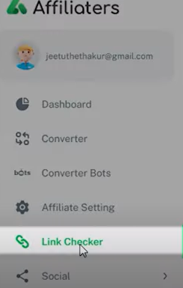
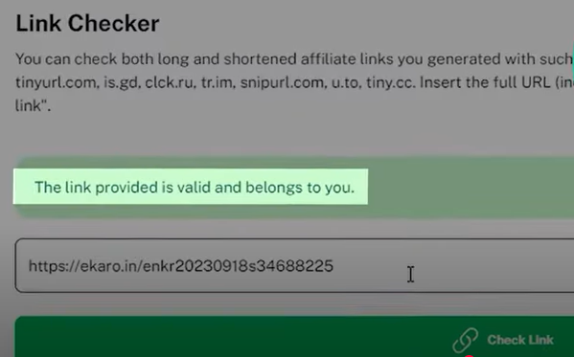
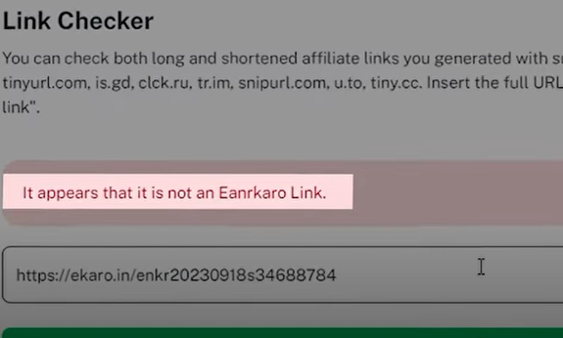
Link Checker
Checking Link Validity:
◦ The tool allows you to easily check if a link is your profit link by simply pasting it into the designated area.
Supported Platforms:
◦ EK Affiliaters supports URLs from major platforms such as Flipkart, Amazon, and Myntra.

Slide 10


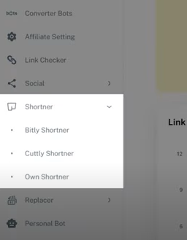
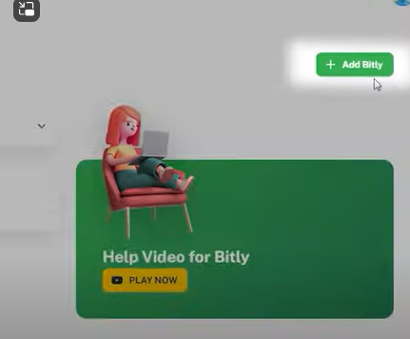
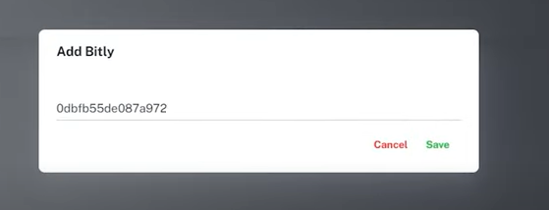
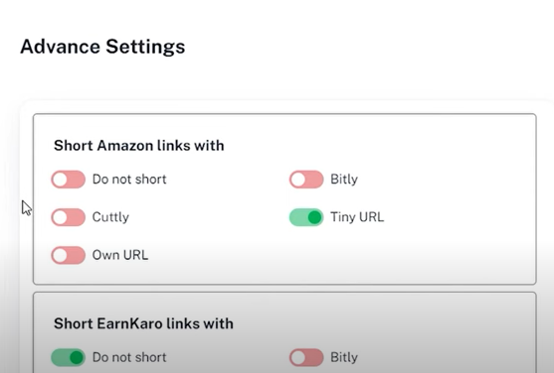
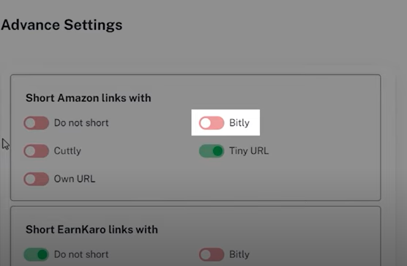
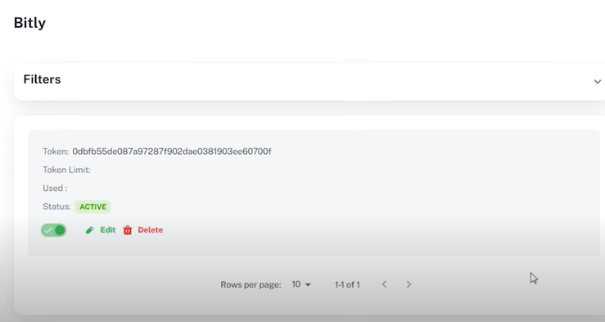
Advanced Settings and Features: Link Shortener
URL Shortener Integration:
◦ You can link your Bitly account by adding your Bitly token in EK Affiliaters; all generated profit links will then be shared as Bitly links
◦ The platform supports Bitly and Cuttly URL shorteners, which can be toggled on or off in advanced settings.
Automatic Text Replacement:
◦ In the advanced settings, you can set up automatic word replacement. For example, if you frequently repost deals and manually change a channel name, you can set it to be replaced automatically in future posts
Comprehensive Controls:
◦ The advanced settings provide access to various controls that you can turn on or off to customize your experience

Slide 11
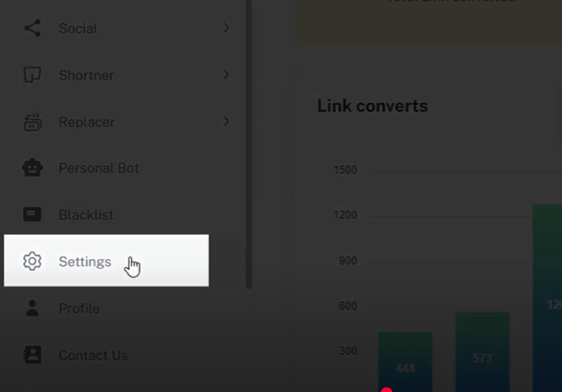
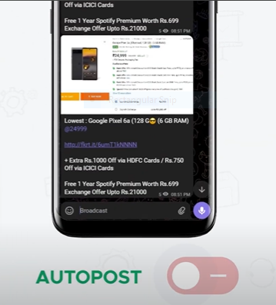
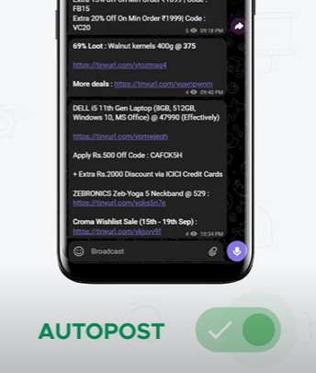
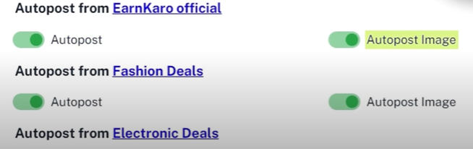


Automate Telegram Channel for Auto-Posting
To enable auto-posting of links from Telegram channels after connecting EK Affiliaters to your Telegram
Follow Below Steps
Auto Post Feature:
◦ In advanced settings, you can toggle the auto-posting feature on or off
◦ When enabled, any new deals posted in, any channel say, EarnKaro's official Telegram channels (EarnKaro Officials, Fashion Deals, Electronic Deals) will be automatically reposted to your linked channel
◦ You have two options for auto-posting: you can enable auto-post for just the text post, or you can enable "auto-post with image“

Slide 12





Converter Bots
To enable conversion of links from Telegram app itself via Converter Bots created and available in EK Affiliates
Follow These Steps
1
2
5
4
3

Slide 13






Automate WhatsApp Groups for Auto-Posting
To enable auto-posting of links from WhatsApp groups after connecting EK Affiliaters to your Telegram
Step-by-Step Flow to Link and Automate Your WhatsApp Group:
Access EK Affiliaters and Socials Section:
◦ First, you need to go to ek.in.
◦ Once on the platform, tap on "Socials".
◦ Then, navigate to the "WhatsApp's" section.
Link Your WhatsApp Device:
◦ Within the WhatsApp's section, go to "Linked Devices".
◦ Tap on "Link a device".
◦ A QR code will appear.
◦ Scan this QR code with your mobile device's WhatsApp application.
Enable Auto-Posting for Your Groups:
◦ After scanning the QR code, your WhatsApp groups will become visible.
◦ To enable automation for a specific group, simply toggle the switch below that group to "enable".
◦ Result: Once enabled, any deals posted on the EK Official channels will automatically be reposted to your linked WhatsApp group.
Follow Below Steps
Note: Continued in next slide

Slide 14








Automate WhatsApp Groups for Auto-Posting
To enable auto-posting of links from WhatsApp groups after connecting EK Affiliaters to your Telegram
How Auto-Posting Works After Linking
Automatic Reposting: After successfully linking your device and enabling the toggle for a specific WhatsApp group, any deals that are posted on the EK Official channels will automatically be reposted to your selected WhatsApp group.
◦ This feature is designed to automate your WhatsApp groups for auto-posting.
◦ This process allows you to use EK Affiliaters to manage automated WhatsApp posting.

Slide 15







Affiliate Settings: Syncing your Amazon Tag with EK Affiliaters
• The Role of Your Amazon Tag: To generate affiliate links for products on Amazon.in, it is absolutely essential to use your Amazon Tag.
• Without the Tag: You cannot create affiliate links for Amazon.in if your Amazon Tag is not utilized. This implies that syncing or making sure your Amazon Tag is connected or recognized by EK Affiliaters is a fundamental prerequisite for earning commissions on Amazon through the platform.
• Your Amazon Tag is the gateway to creating valid and trackable affiliate links for Amazon.in within the EK Affiliaters platform. Ensure it is correctly recognized and used to facilitate your Amazon affiliate activities.
Follow These Steps

Slide 16







Affiliate Settings: Obtaining Your Flipkart Tag
Follow These Steps
Connected with Your Account Manager to get the Tag
Tag for App
Two Format Options: You will have two distinct formats available to choose from for your Flipkart Tag: flipkart.com & fkrt.it
Usage Based on Format: You should choose the format that suits your usage:
◦ The fkrt.it format is designed to open exclusively on the Flipkart app.
◦ The source implies that you should choose based on your usage, suggesting the flipkart.com option is for web use, but this is an inference based on the "app-only" description of fkrt.it.
Tag for Website

